Slide 1

City Microclimate and Traffic Analysis
Fyrogeni Ariadne 1083816
Psychogiou Georgia 1083979

Slide 2
Operations
Accurate microclimate forecasts and predictions by combining meteorological data from open APIs with real and virtual local weather data from sensors.
Calculation of the correlation index between traffic data and various microclimate parameters (such as wind, rain amount and temperature) depending on the point of interest under study.
UI visualization of heatmaps and graphs indicating the progression of traffic versus key microclimate parameters’ alternations.
Alerts and warning reports concerning slippery roundabouts caused by severe rainfall, dangerously windy bridges, road closures due to flood or fallen trees and frozen roads because of snow.

Slide 3
Requirements
Resources
Accurate microclimate data in specific locations
Numerous environmental sensors, sparsely located
Data ingestion
MQTT, HTTP
Historical environmental and traffic data
Data Bases
High availability of collected data and system future scalability
FIWARE context broker
Notes:
Accurate microclimate data in specific locations in the city -> numerous environmental sensors, sparsely located
Real-time data ingestion from sensors and APIs (reliable & low latency communication) -> LoRa Wide Area Network (εκμαίευση δεδομένων)
Historical environmental and traffic data (not available by APIs) for finding systematically observed deviations between regional weather data and microclimate data from sensors and correlation between circulation and microclimate -> save in Data Bases (InfluxDB, SQLite3)
High availability of collected data and system future scalability -> FIWARE [context broker: enables the integration of data from multiple systems and supports organizations to display and understand their data]

Slide 4

System Architecture
Connector
InfluxDB
Grafana
MQTT broker
Front-end (Website)
Context broker
Sensors
Request API
publish
subscribe
NGSI RESTful API
Data Processor
Back-end
http
Data Ingestion
Weather API
Update API
SQLite3
Traffic API
http
Visitors API
Sensors Data
Localized data
http
Weather API Data
Correlation
Traffic API
Notes:
Data Input:
Sensors publish real-time data to the MQTT broker.
Weather and traffic APIs fetch complementary data.
Data Processing:
Subscriber processes MQTT messages and stores them in InfluxDB.
Data from APIs are stored in InfluxDB as well.
Data Analysis:
API data is localized by comparing it with sensor data.
Perform statistical analysis (e.g., correlation) using Python.
Data Output:
Serve data to the web dashboard.
Visualize heatmaps and graphs.
Report warnings.

Slide 5
DATA PROCESSING
Connector
InfluxDB
Grafana
MQTT broker
Front-end (Website)
Context broker
Sensors
Request API
publish
subscribe
NGSI RESTful API
Data Processor
Back-end
http
Data Ingestion
Weather API
Update API
SQLite3
Traffic API
http
CLOUD
Visitors API
http
VIRTUAL GATEWAY
Notes:
Data Input:
Sensors publish real-time data to the MQTT broker.
Weather and traffic APIs fetch complementary data.
Data Processing:
Subscriber processes MQTT messages and stores them in InfluxDB.
Data from APIs are stored in InfluxDB as well.
Data Analysis:
API data is localized by comparing it with sensor data.
Perform statistical analysis (e.g., correlation) using Python.
Data Output:
Serve data to the web dashboard.
Visualize heatmaps and graphs.
Report warnings.

Slide 6
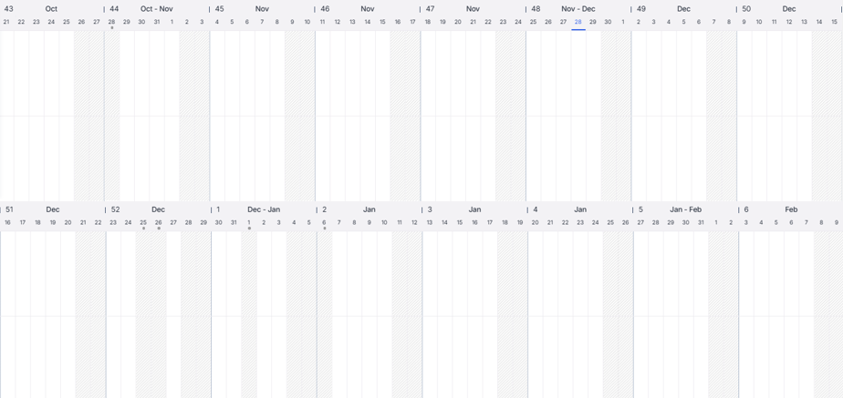
Work schedule
Configuration of the project idea
System Architecture study
Sensors and APIs’ data management
Virtual Gateway
Syntax of 1st presentation
Syntax of 2nd presentation
Virtual Gateway
Virtual Gateway
Data processing
Cloud
Website composition
Data processing
Cloud
Website composition
Georgia Psychogiou
Ariadne fyrogeni

Slide 7



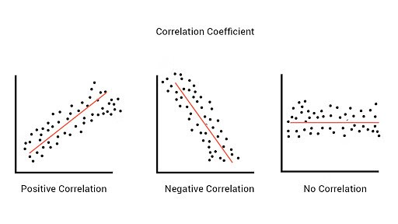





Technologies - Tools
Python
JavaScript
Pearson Correlation
Fiware
Grafana
GitHub
Figma
Open Weather Map
Tom Tom
Notes:
Pearson correlation, also known as linear correlation, measures the linear relationship between two continuous variables. Pearson correlation is indicated by the value of the correlation coefficient r

Slide 8
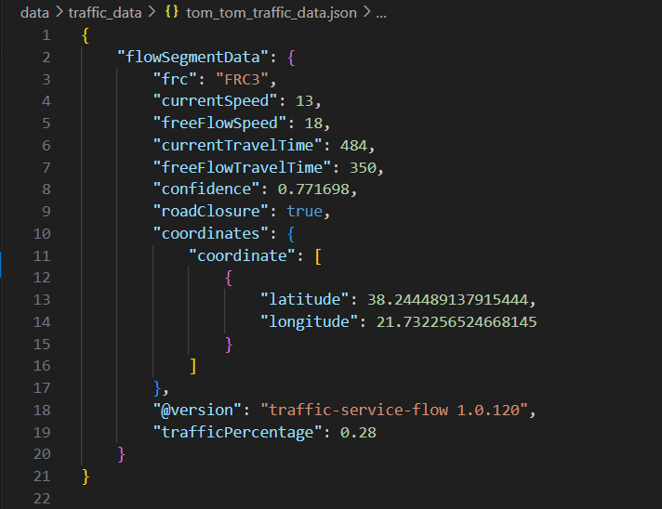

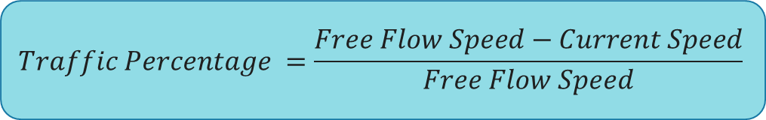
Tom-tom api
$$Traffic Percentage =\frac{Free Flow Speed−Current Speed}{Free Flow Speed}$$
Notes:
Traffic incidents: traffic jams, road closures, lane closures, construction zones and other road incidents.
currentSpeed: The current average speed of vehicles on the road segment, measured in kilometers per hour.
freeFlowSpeed: The typical speed for this road segment under free-flow (ideal traffic) conditions, measured in kilometers per hour. Since it matches the currentSpeed, this suggests there is no traffic congestion.
currentTravelTime: The estimated time it takes to travel through the road segment under current traffic conditions, measured in seconds. Here, it's about 27 minutes and 9 seconds.
freeFlowTravelTime: The estimated travel time under free-flow (no traffic) conditions, measured in seconds. Since this matches the currentTravelTime, it indicates that traffic is moving at the expected speed.
confidence: A measure of confidence in the traffic data's accuracy, ranging from 0 (low) to 1 (high). Here, the value is 1, indicating highly reliable data.
roadClosure: Indicates whether the road segment is closed. false means the road is open for travel.
coordinates: This object contains the geographic coordinates of the road segment. The latitude and longitude of a point within the road segment. This is a specific geographic location (in decimal degrees) that represents or lies within the road segment.

Slide 9
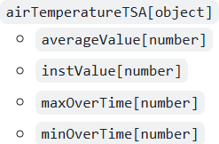


Smart data model
https://github.com/smart-data-models/dataModel.Weather/blob/master/WeatherObserved/doc/spec.md

Slide 10
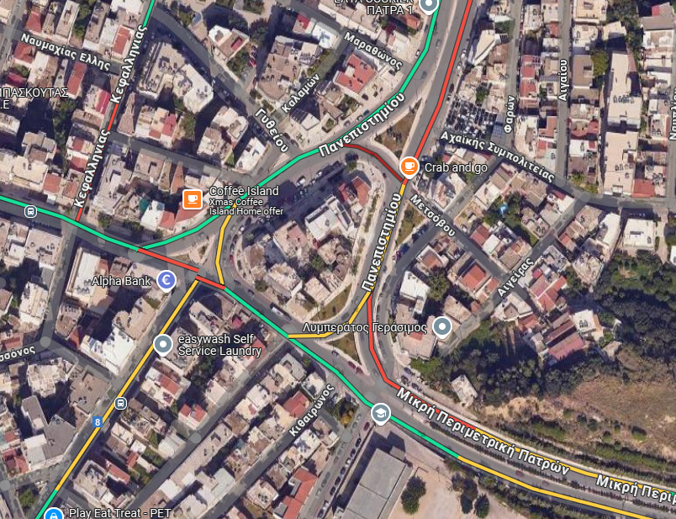
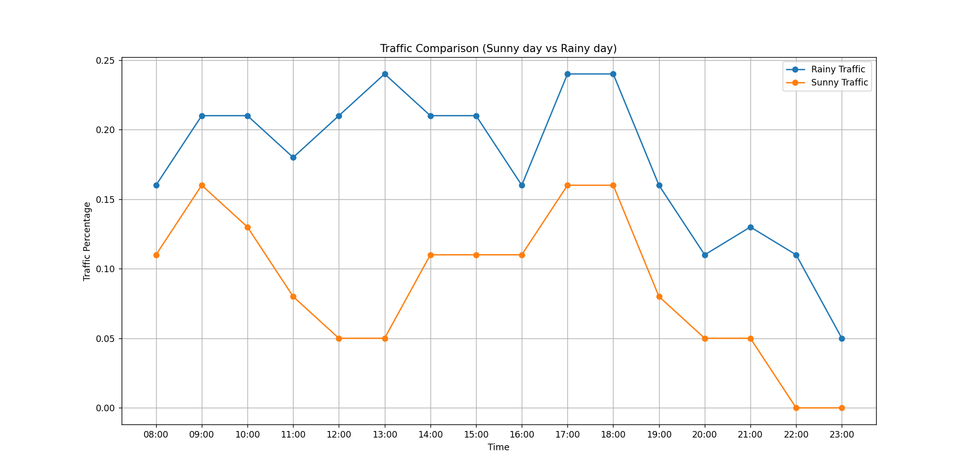
Demo

Slide 11
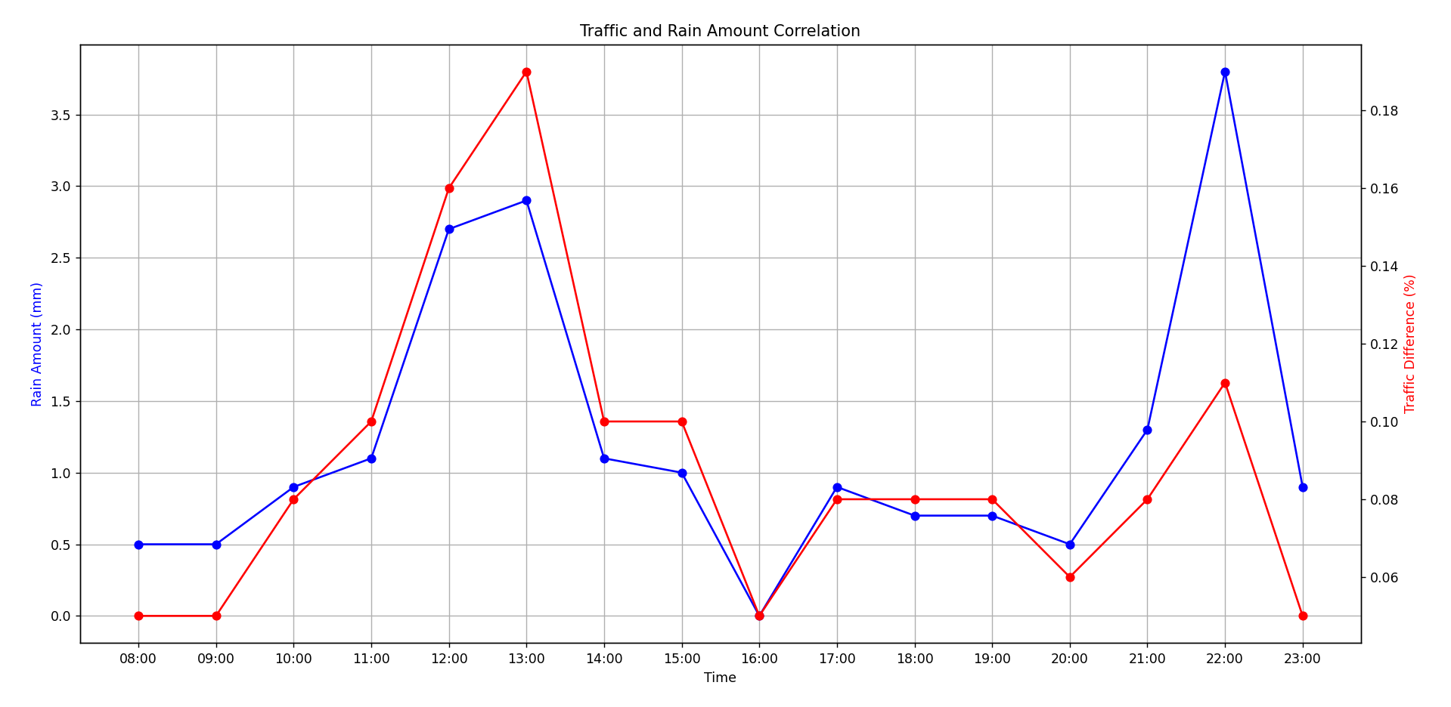
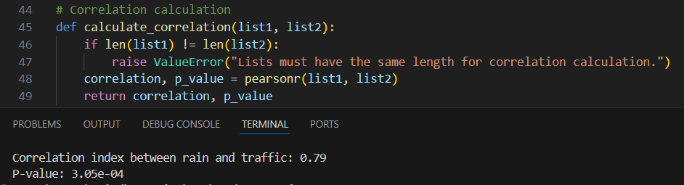
Microclimate and traffic correlation

Slide 12
THANK YOU!
Any questions?

